Slide 1
B09S0061 Software Engineering
Lecture 12
Instructor: Liu, Guangchi Ph.D.
2025/05/23
Notes:
本模板基于“中国科学院大学-路人丁-PPT模板”魔改而成，著作权归该作者所有。
本模板中使用的东南大学校徽、校标文字组合、校训文字等素材来自于微信公众号“金木屋”。
本模板的视觉设计参考了“东南大学视觉识别系统”。
人物介绍页头像素材来自 小肥柴。
本模板力求简洁，布局合理，主次分明。以学术风为设计理念，适用于学术报告与论文答辩等相关应用场景。模板未使用任何动画效果。
您仅可以以个人非商业用途使用本PPT模板，不可将信息内容的全部或部分用以出售，或以出租、出借、转让、分销、发布等其他任何方式供其他人使用。
欢迎 持续关注东南大学止于至善学术风 PPT 模板 （https://zhuanlan.zhihu.com/p/335298500）后续的功能优化及多语言更新版本。
最后，祝汇报顺利，马到成功！
Version: (2021) v1.5-en.

Slide 2
Heads Up
4th Lab: Jun 7th (Saturday), 14:00 – 17:25, J6-102 (Lecture Classroom)

Slide 3
Heads Up
4th Assignment will be uploaded to 微助教 next Monday （May 26th 23:55 pm）， Due on June 2nd, 23:55 pm

Slide 4
Heads Up
Final Project Report：Due on June 12th, including: final report.pdf, demo video, github link
Send to your TA via QQ

Slide 5
01
PART ONE
Course Review

Slide 6
Grading Scale
Attendance/In-Class Questions: 30%
Randomly pick students to answer my questions --- 10%
Will lose points if you don’t show up or respond well (Second-major student is excluded)
4 take-home assignments --- 20%
Score will be counted individually
Final Exam: 40%
Jun 12nd, 14:00-16:00, J6-301/302
Basic concepts and understandings
Single-choice, true/false and short-answer questions (like the take-home assignments)
Closed-book exam
Lecture 1 ~ 11
15 single choice, 15 true/false, 5 short answers
Score will be counted individually

Slide 7
Grading Scale
Project: 30%
Accomplish an industrial project, e.g., developing a SaaS App on cloud
4 ~ 6 students a team
Claim your Project Name, Team Name, Members in Team Info (QQ 群在线文档)
Follow the process learned in class and show your own contribution
4 Labs: discuss with us about your project following the process
Requirements, System Design, Program Dev, Testing
Final Report: report file (.pdf), source code (github/gitee link) and demo video
Will include the major components in software development process (introduce later)
Every student in this class will have HuaweiYun credits for project development
Score will be counted grouply
Input (Text, Image, Query)
Terminal
Service
Local Machine
Output (Sentiment, Category, Result)
Cloud (Huawei)

Slide 8
Contents Covered in this Course^{[1,2,3]}
Introduction
Requirements
02
01
Process, Terminologies
Tools
Analysis, Modeling
03
Design
Testing
04
UI, System, Program
Unit/ Integrated Test
05
Management
Legal, Risk, QA
[1] Software Engineering, Yue Chen, et al. Zhejiang University https://www.bilibili.com/video/BV16g411M7r2?p=1
[2] Software Engineering, Curran Muhlberger, et al. Cornell University, https://www.cs.cornell.edu/courses/cs5150/2022sp/
[3]伊恩·萨默维尔(Ian Sommerville).软件工程(原书第10版)，机械工业出版社 (2018-02出版)

Slide 9
Software Development Process
Feasibility and planning
Requirements
User Interface/Experience design
System design
Program development (coding part)
Acceptance and release
Operation and maintenance
May be repeated during the development cycle
Distinguish among these steps
These are the major contents covered in this course and will be presented in your project report

Slide 10
Software Development Processes
Waterfall model
Complete each process step before beginning the next.
Iterative refinement
Go quickly through all the steps to create a rough system, then repeat them to improve the system
Spiral
A variant of iterative refinement in which new and updated components are added to the developing system as they are completed.
Agile development
Small increments of software are developed in a sequence of sprints, eachof which creates deployable code.

Slide 11
Iterative Refinement
Concept
Requirements are hard to understand until there is an operational system, particularly with user interfaces.
System and program design may benefit from prototypes.
Process
Create a prototype system early in the development process.
Review the prototype with clients and test it with users, to improve the understanding of the requirements and clarify the design.
Refine the prototype in a series of iterations.

Slide 12
Discussion of Iterative Refinement
This is a medium weight process with documentation created during the process.
Iterative refinement uses various techniques that enable the client to review the planned system early during development:
User interface mock-ups
Throw-away software components
Dummy modules
Rapid prototyping
Successive refinement
Get something working as quickly as possible, for client and user evaluation, but do not release it.

Slide 13
Spiral Development
Example
Developing a new version of an operating system (Microsoft).
Spiral development
With spiral development there is always a fully tested system, but the functionality is incomplete.
Create a base system that has the overall structure of the final product with dummy stubs for missing components.
For every completed component, create a comprehensive set of test cases.
Development teams build new or improved components, each with a set of test cases. Add these components to the source code library.
On a daily cycle, testers build the entire system from the source code library and run the complete set of test cases.

Slide 14
Discussion of Spiral Development
Spiral development is widely used to develop new versions of large systems:
The overall system architecture is well understood.
Large components can be developed and tested separately.
The importance of the system justifies the overhead of setting up a comprehensive set of automated tests.
Challenges
Difficult to make major changes to the architecture.
Difficult to make changes that effect many components.

Slide 15
Agile Methods
The term Agile is used for a variety of methods.
General principles:
A large project is divided into small increments called sprints.
The development is carried out by small teams of 4 to 9 people.
The schedule is divided into fixed time boxes, perhaps 2 to 4 weeks.
Each sprint is a time box during which the team completes part of a software project. A single sprint will go through several process steps, such as requirements, design, coding, and testing. Each sprint ends with fully tested code, ready to be put into production.
This is a lightweight process with minimal documentation created during the process, but the final version needs full documentation for future maintenance.

Slide 16
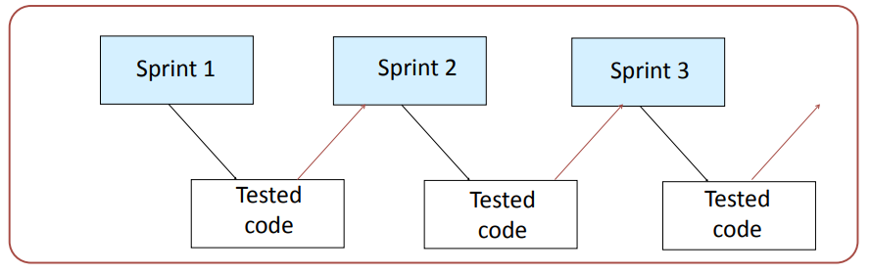
Agile Development
After each sprint the code may be:
released (original agile method)
combined with code from other sprints for subsequent release
incorporated into a larger code base (spiral development)

Slide 17
Heavyweight and Lightweight Software Development
In a heavyweight process, the aim is to fully complete each step and have minimal changes and revisions later. Each step is fully documented before beginning the next.
Example: Modified Waterfall Model
In a lightweight process, the development team has minimal intermediate documentation. There is an expectation that changes will be made based on experience, and only the final system will be documented.
Example: Agile Software Development

Slide 18
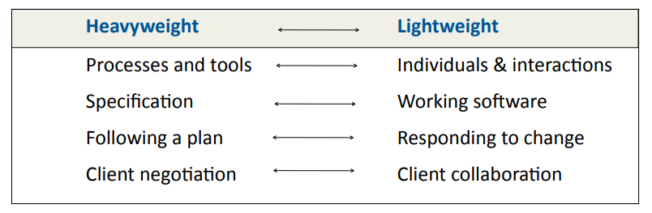
Heavyweight and Lightweight Methodologies
过程和工具 v.s. 个体和交互
面面俱到的文档 v.s. 可以工作的软件
遵循计划 v.s. 响应变化
合同谈判 v.s.客户合作
Based on the Manifesto for Agile Software Development:
http://agilemanifesto.org

Slide 19
Feasibility Study
A feasibility study is a study made before committing to a project.
A feasibility study leads to a decision:
• go ahead
• do not go ahead
In production projects, the feasibility study often leads to a budget request.
A feasibility study may be in the form of a proposal.

Slide 20
Feasibility Report
A feasibility study should have a written report.
It should be a well written, well presented document.
• For a general audience: client, financial management, technical management,etc.
• Short enough that everybody reads it.
• Long enough that no important topics are skipped.
• Details can be included in supporting documents.
A report that is not read and understood is useless.

Slide 21
The Aim of Project Management
To complete a project:
• On time
• On budget
• With required functionality
• To the satisfaction of the client
• Without exhausting the team
To provide visibility about the progress of a project
To give early warning of problems so that corrections can be made

Slide 22
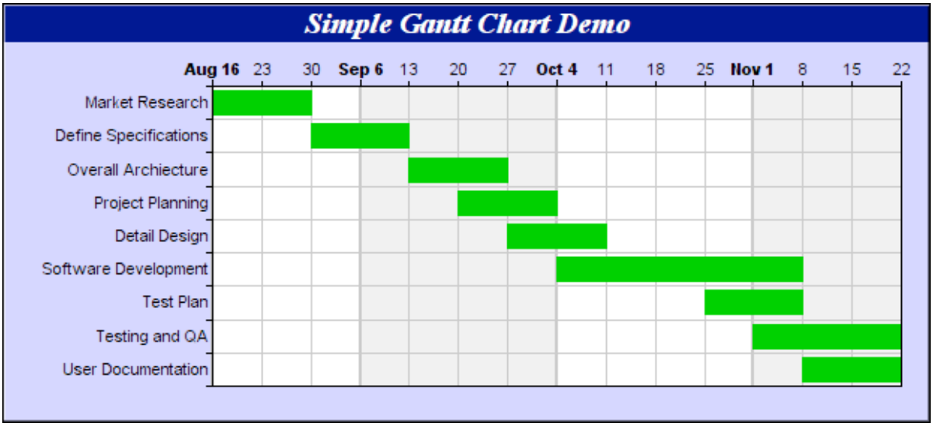
A Simple Gantt Chart
Source: Advanced SoIware Engineering Limited

Slide 23
Gantt Charts
Used for small projects, single time-boxes, and sprints
• Dates run along the top (days, weeks, or months).
• Each row represents an activity. Activities may be sequential, in parallel or overlapping.
• The schedule for an activity is a horizontal bar. The left end marks the planned beginning of the task. The right end marks the expected end date.
• The chart is updated by filling in each activity to a length proportional to the work accomplished. This is often difficult.
• Progress to date can be compared with the plan by drawing a vertical line through the chart at the current date.

Slide 24
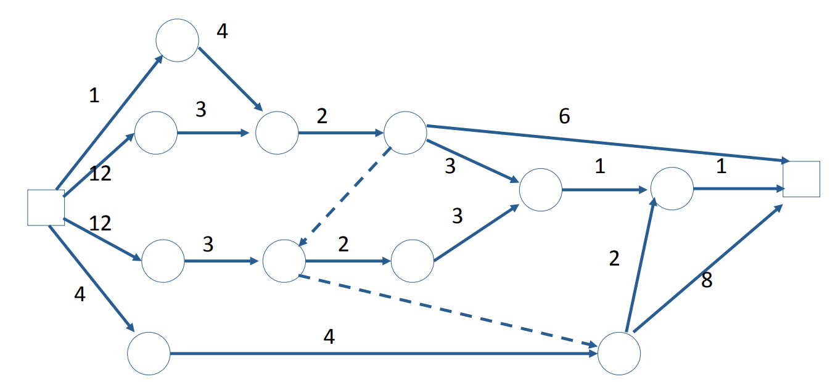
Example:Activity Graph w/ Time Estimate

Slide 25
Earliest Event Dates and Earliest Start Dates
Earliest start date: the earliest date that it is possible to start an activity.
Earliest event date: the date that all the activities ending at that node will be completed, assuming that every activity begins at its earliest start date.
Earliest project completion date: the date on which the project is completed assuming that every activity begins on its earliest start date.
These calculations all depend on the dependencies represented by the activity graph and the accuracy of the estimates of the time to carry out the individual tasks.

Slide 26
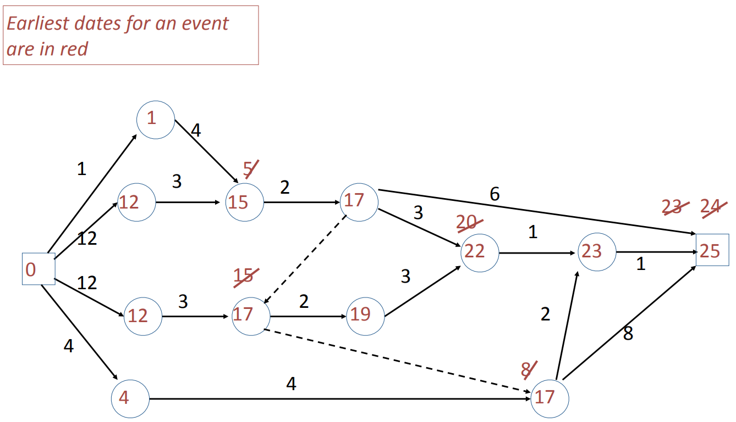
Earliest Event Dates and Earliest Start Dates

Slide 27
Latest Event Dates and Latest Start Dates
Latest start date: the latest date that it is possible to start an activity and still complete the project by the earliest project completion date.
Latest event date: the latest date that all the activities ending at that node must be completed, in order to complete the project by the earliest project completion date.

Slide 28
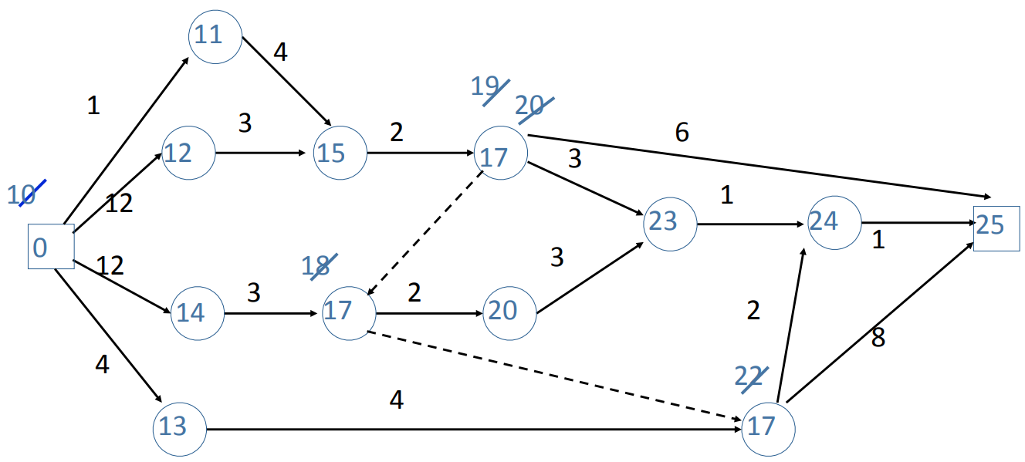
Latest Event Dates and Latest Start Dates
Latest event
dates in blue
Each event must be achieved by the date shown or the final date will not be met.

Slide 29
Critical Path
Events on the critical path have the earliest event date equal to the latest event date.
Every activity on the critical path must begin on the earliest start date.
Critical path in orange

Slide 30
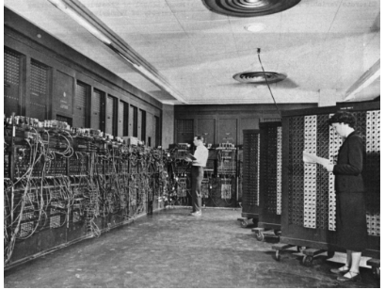
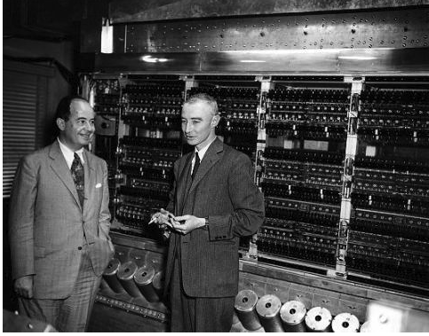
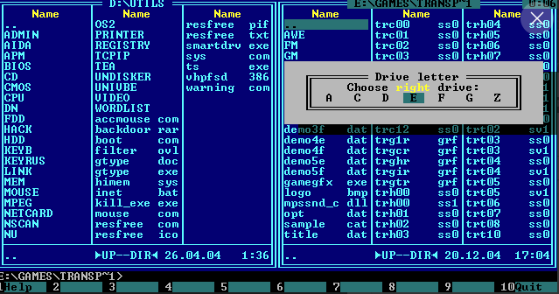
User Experience
User experience (UX)
The user experience (UX) refers to the total of all the factors that contribute to the usability (or otherwise) of a computer and its systems.
User interface (UI)
The user interface (UI) refers to the interactivity, look, and feel of a product screen or web page
Human computer interaction (HCI)
Human computer interaction is the academic discipline that studies how people interact with computers.
Computing Machine without UI:

Slide 31
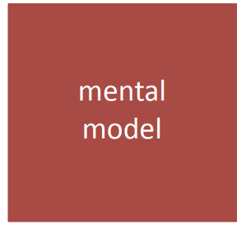
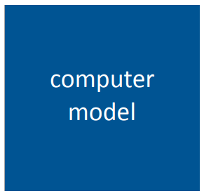
Mental Model and Computer Model
Mental Model
The mental model is the user’s view of the system and the user experience that it provides.
Computer Model
The computer model is the functions, data, content, etc. provided by the system.

Slide 32
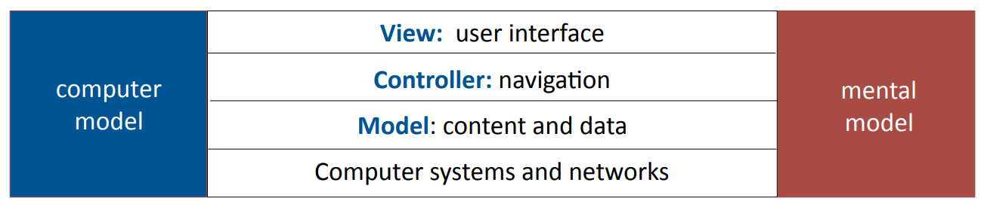
The Model View Controller
The Model View Controller (MVC) is a computer model with layers that correspond to the layers of the mental model.
It is a very widely used model for interactive systems.

Slide 33
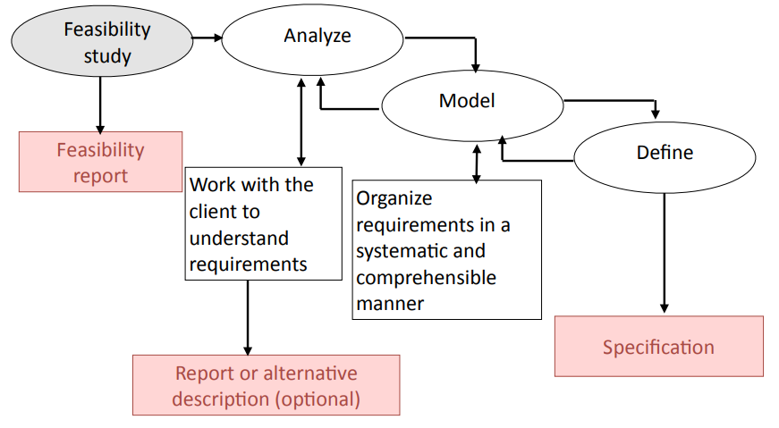
Requirements Steps

Slide 34
Requirement Goals
Understand the requirements in appropriate detail.
Ensure that the client and developers understand the requirements and their implications.
Define the requirements in a manner that is clear to the client. This may be a written specification, prototype system, or other form of communication.
Define the requirements in a manner that is clear to the people who will design, implement, and maintain the system.
"Our understanding of your requirements is that ...”

Slide 35
Non-Functional Requirements
Requirements that are not directly related to the functions that the system must perform
Product requirements performance, reliability, portability, etc...
Organizational requirements delivery, training, standards, etc...
External requirements legal, interoperability, etc...
Marketing and public relations

Slide 36
Requirements vs. System Design
Technical decisions
Requirements analysis should make minimal assumptions about the system design.
But the requirements definition must be consistent with computing technology and the resources available.
In practice, analysis and design are interwoven. However:
1. Do not allow assumptions about the design to influence the requirements analysis.
2. Do not to allow the requirements analysis to prejudge the system design.

Slide 37
Scenario
Scenario
A scenario is a scene that illustrates some interaction with a proposed system.
A scenario is a tool used during requirements analysis to describe a specific use of a proposed system. Scenarios capture the system, as viewed from the outside, e.g., by a user, using specific examples.
Note on terminology
Some authors restrict the word "scenario" to refer to a user's total interaction with the system.
Other authors use the word "scenario" to refer to parts of the interaction.
In this course, the term is used with both meanings.

Slide 38
Describing a Scenario
Some organizations have complex documentation standards for describing a scenario.
At the very least, the description should include:
A statement of the purpose of the scenario
Choose a viewpoint
The individual user or transaction that is being followed through the scenario Assumptions about equipment or software
The steps of the scenario
In Agile development, a scenario is described as a user story

Slide 39
Requirement Modeling
Models
Scenarios are useful in discussing a proposed system with a client, but requirements need to be made more precise before a system is fully understood.
This is the purpose of requirements modeling.
A use case provides such a model.

Slide 40
Use Case Diagrams
Use case diagrams
A use case diagram shows the relationships between actors and their interactions with a system.
It does not show the logic of those interactions

Slide 41
UML Models
Models used mainly for requirements
Use case diagram shows a set of use cases and actors, and their relationships.
Models used mainly for systems architecture
Component diagram shows the organization and dependencies among a set of components.
Deployment diagram shows the configuration of processing nodes and the components that live on them.
Models used mainly for program design
Class diagram shows a set of classes, interfaces, and collaborations with their relationships.
Object diagram or sequence diagram show a set of objects and their relationships.

Slide 42
Models: Diagrams and Specification in UML
In UML, a model consists of a diagram and a specification.
A diagram is the graphical representation of a set of elements, usually rendered as a connected graph of vertices (things) and arcs (relationships).
Each diagram is supported by technical documentation that specifies in more detail the model represented by the diagram.
A diagram without a specification is of little use

Slide 43
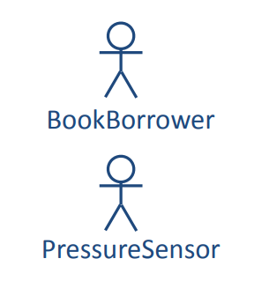
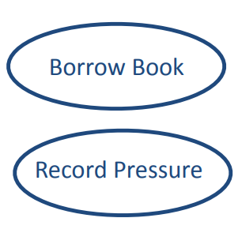
Actor and Use Case Diagram
An actor is a user of a system in a particular role.
An actor can be human or an external system.
A use case is a task that an actor needs to perform with the help of the system.

Slide 44
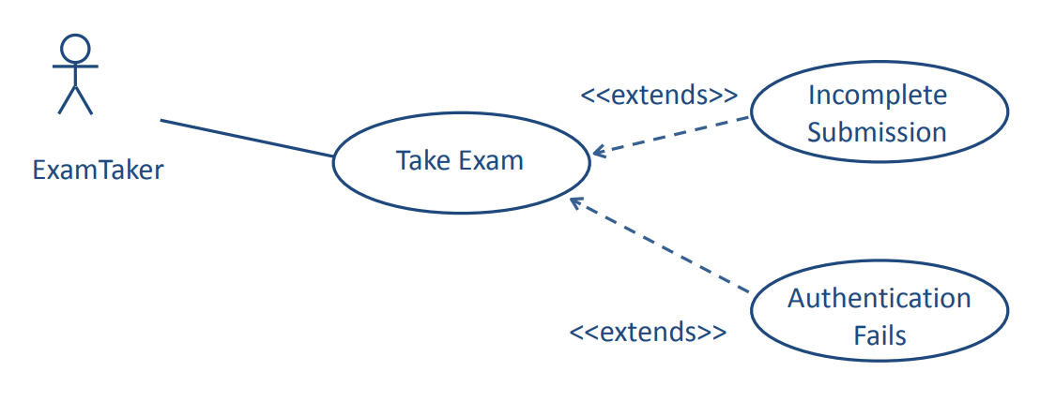
Relationships Between Use Cases: <<extend>>

Slide 45
The <<extends>> Relationship
The «extends» relationship
Uses cases can make use of other use cases
If an alternate flow or an exception needs extra detail, it can be modeled as a separate use case using the «extends» relationship.

Slide 46
The <<includes>> Relationship
The «includes» relationship
The «includes» relationship allows a use case to include the steps from another use case.
This is valuable when the included use case occurs in other contexts. It is often developed independently.

Slide 47
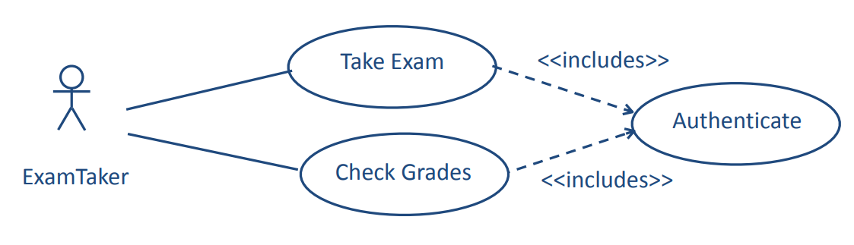
Relationships Between Use Cases: <<includes>>
The Authenticate use case may be used in other contexts.

Slide 48
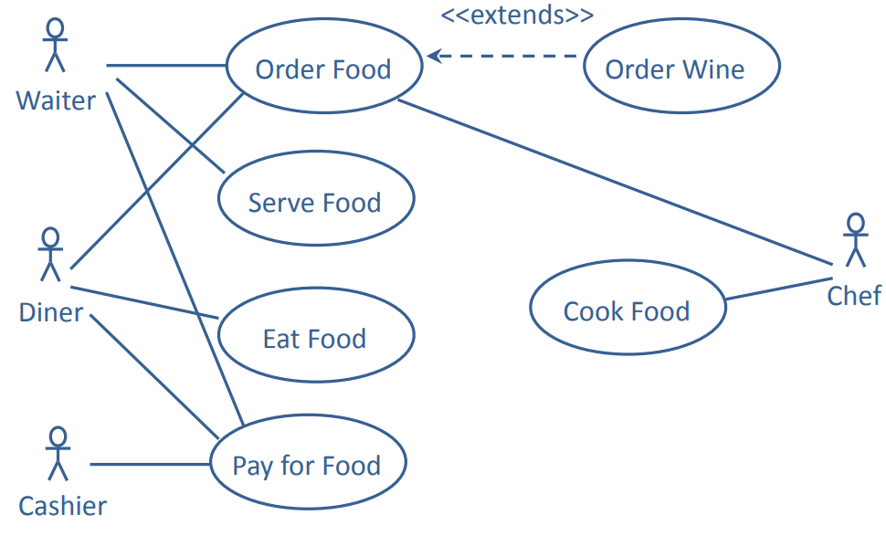
Use Cases with Several Actors

Slide 49
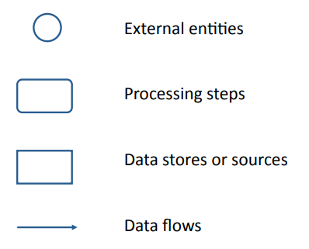
Data-Flow Models
An informal modeling technique to show the flow of data through a system.

Slide 50
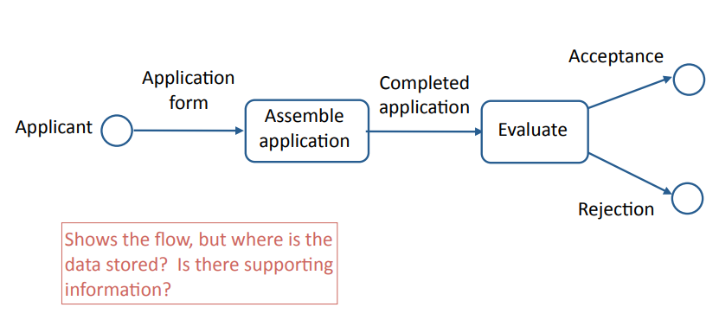
Data-Flow Model Example: University Admissions (first attempt)
Any Problems?

Slide 51
Data-Flow Model Example: University Admissions (first attempt)

Slide 52
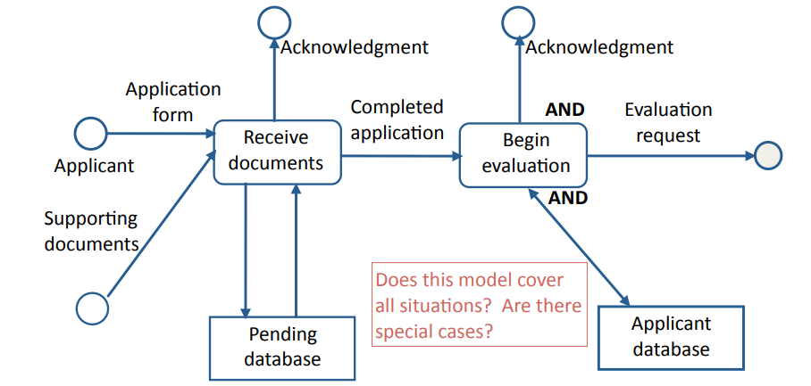
Data-Flow Model Example: Assemble Application

Slide 53
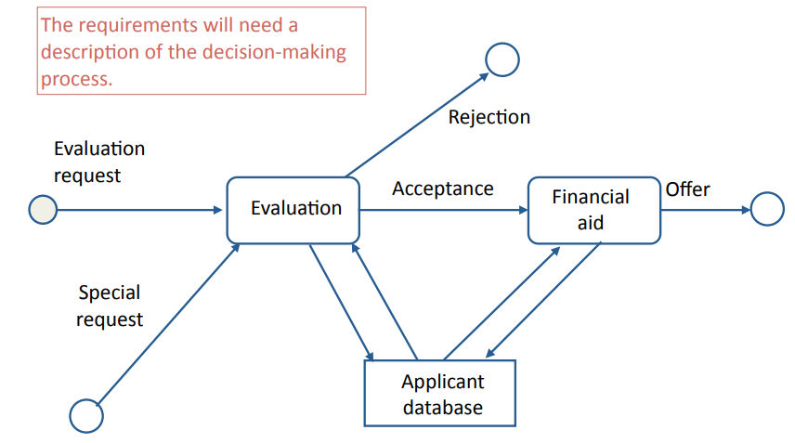
Data-Flow Model Example: Process Completed Application

Slide 54
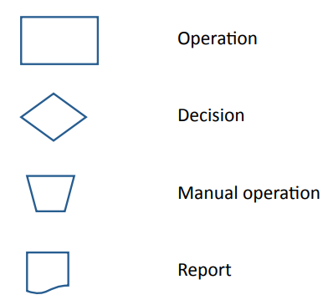
Flowchart Models
An informal modeling technique to show the logic of part of a system and paths that data takes through a system.

Slide 55
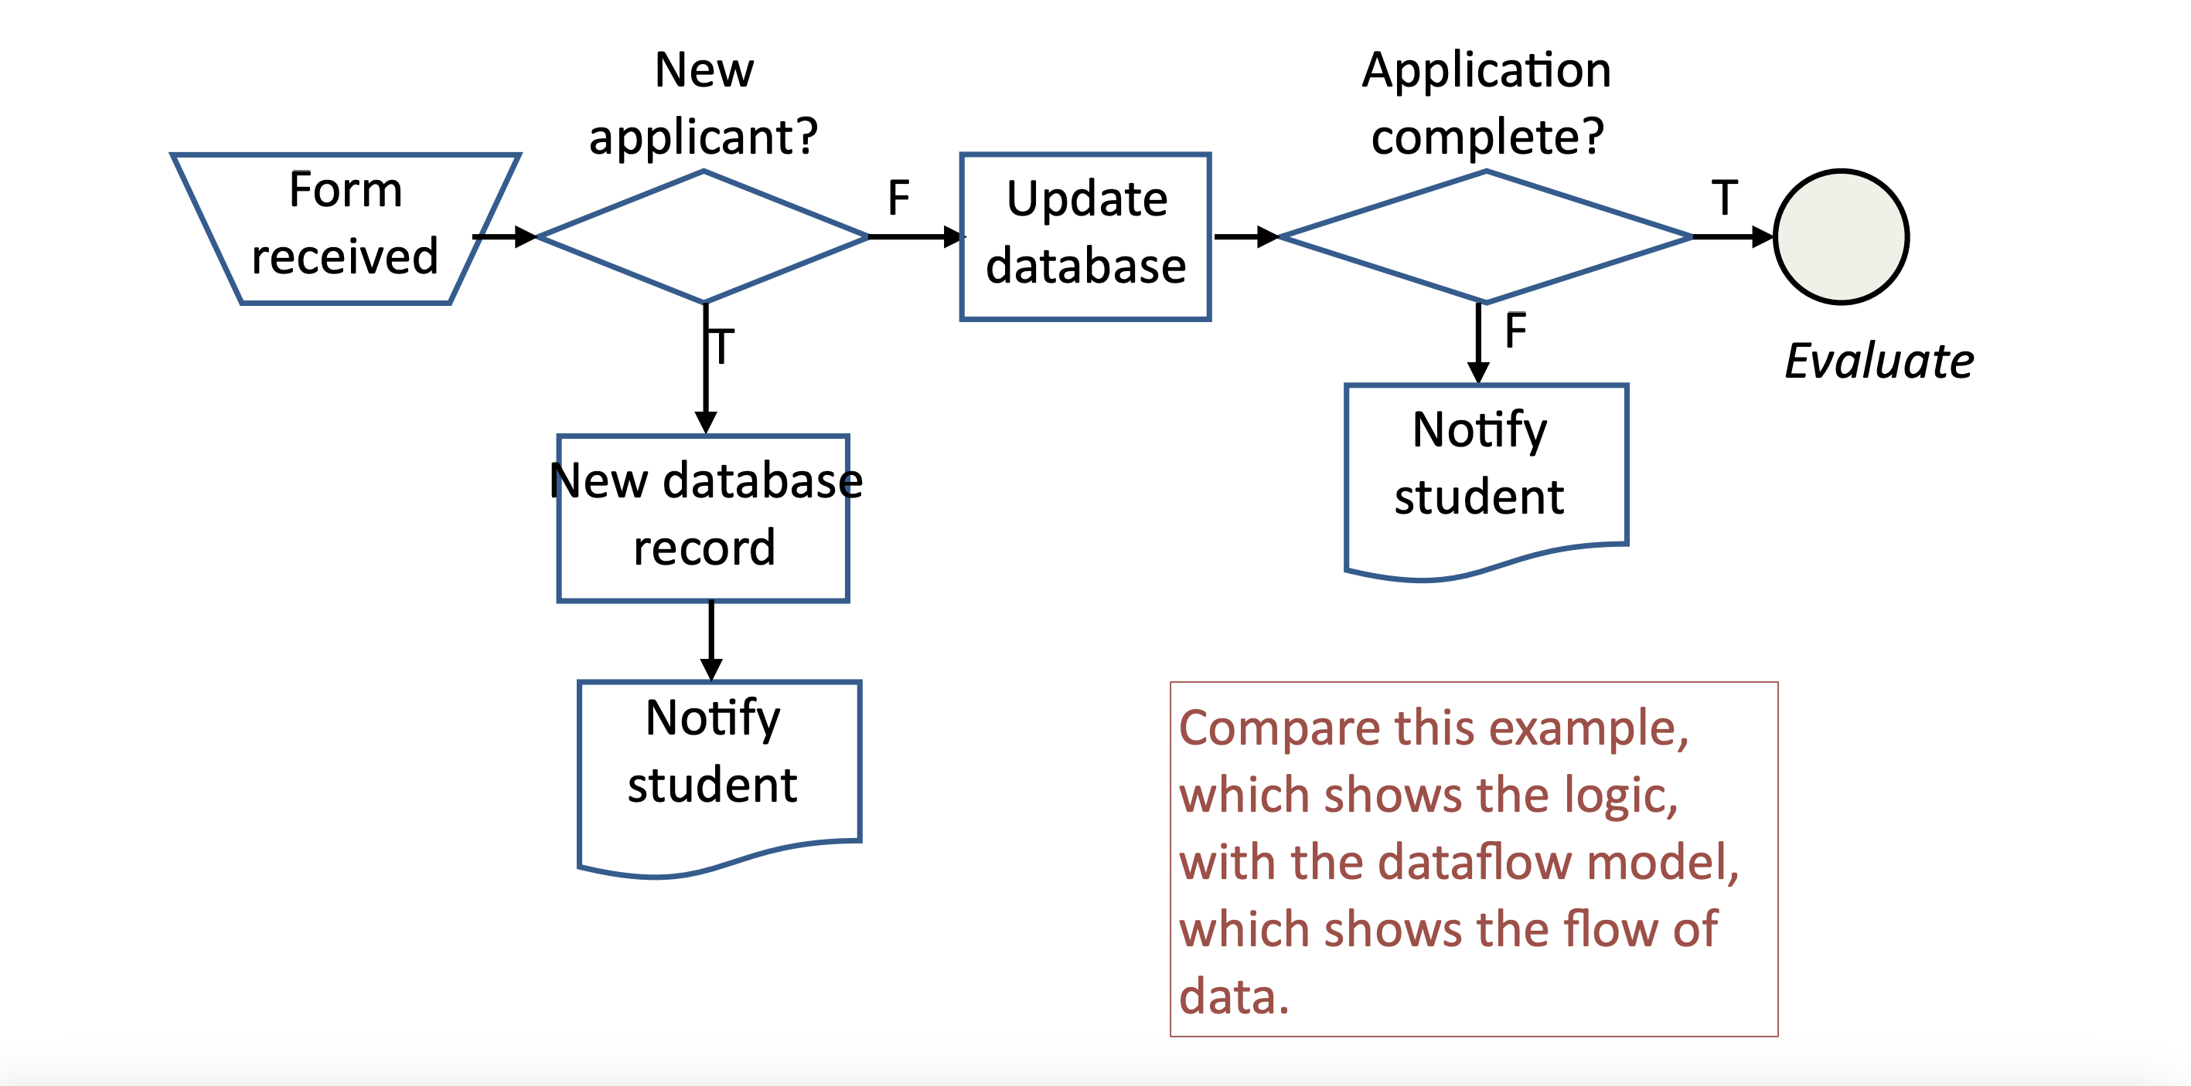
Example: University Admissions Assemble Application
Compared with Data-flow?

Slide 56
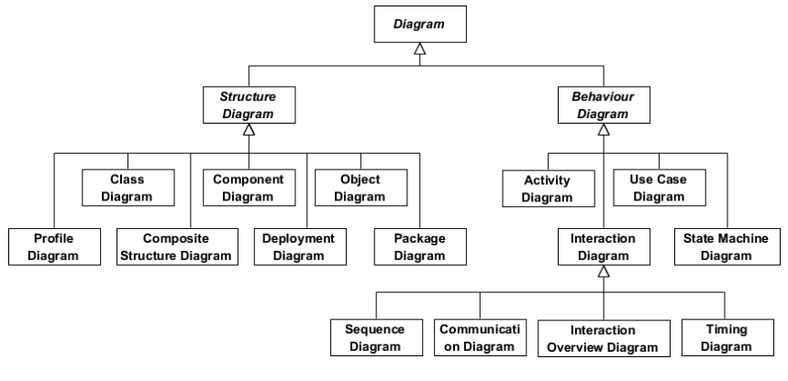
Diagrams for System Architecture

Slide 57
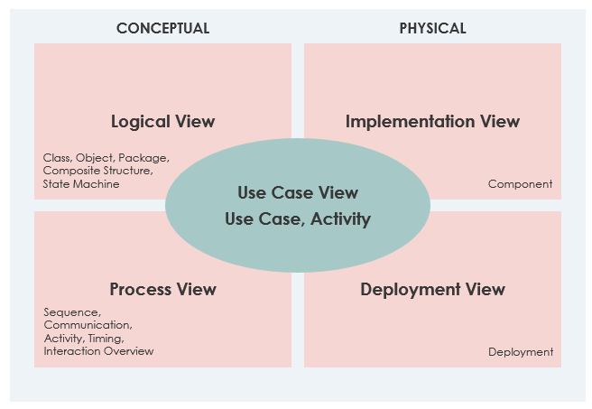
Purpose of Various Diagrams
Use Case View
Logical View
Implementation View
Process View
Deployment View

Slide 58
Component Diagram
A component is a replaceable part of a system that conforms to and provides the realization of a set of interfaces.
A component can be thought of as an implementation of a subsystem.
UML definition of a component
"A distributable piece of implementation of a system, including software code (source, binary, or executable), but also including business documents, etc., in a human system."

Slide 59
Components as Replaceable Elements
Components allow systems to be assembled from binary replaceable elements.
• A component is bits not concepts.
• A component can be replaced by any other component(s) that conforms to the interfaces.
• A component is part of a system.
• A component provides the realization of a set of interfaces.

Slide 60
Component Diagram vs. Class Diagram
Classes represent logical abstractions（Not covered in this lecture, will be shown in Program Design）
They have a Tributes (data) and operations (methods)
Classes can be combined to form programs (i.e., for program design)
Components have operations that are reachable only through interfaces.
Components can be combined to form systems (i.e., for system design)

Slide 61
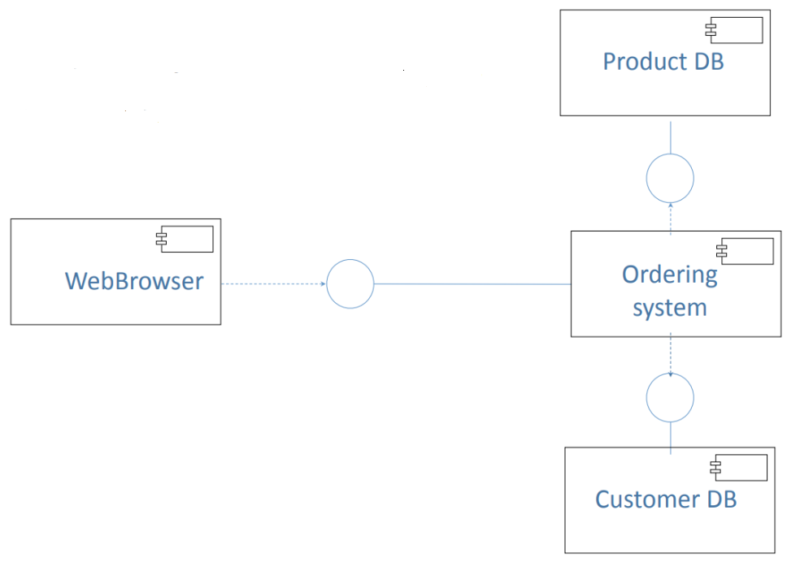
An Old Exam Question

Slide 62
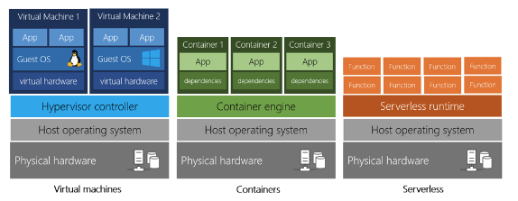
Comparison of Virtualization

Slide 63
Security Techniques: AuthN and AuthZ
Authentication (AuthN) establishes the identity of an agent:
What does the agent know (e.g., password)?
What does the agent possess (e.g., smart card)?
What does the agent have physical access to (e.g., crt-alt-del)?
What are the physical properties of the agent (e.g., fingerprint)?
Authorization (AuthZ) establishes what an authenticated agent may do:
Access control lists
Group membership

Slide 64
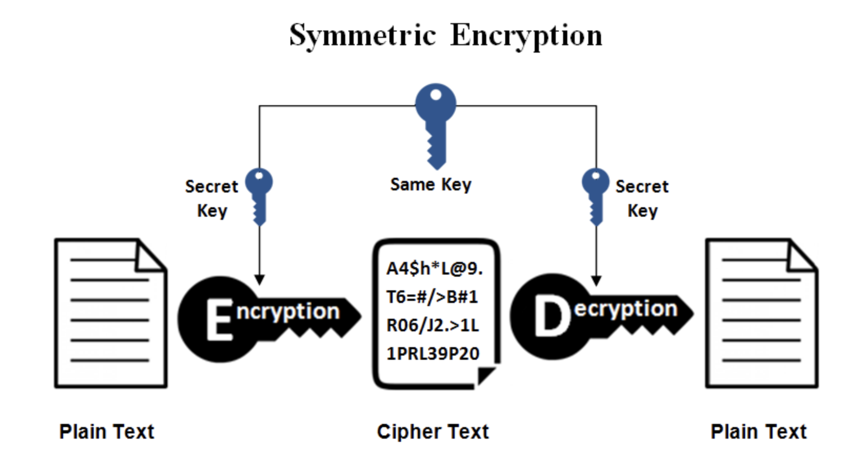
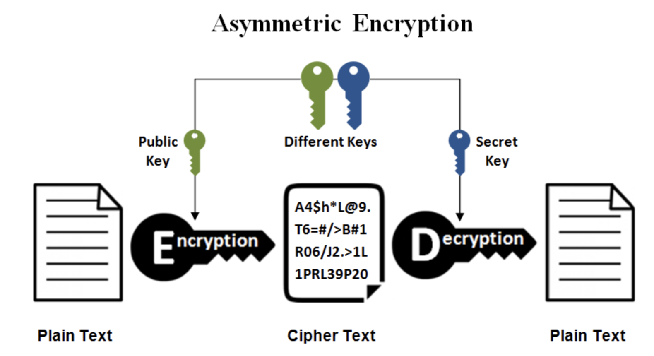
Asymmetric vs. Symmetric
Asymmetric Encryption
Generated by one side, only public key is shared
Secure, but high overhead for PC
X
Y
Symmetric Encryption
Generated by one side, shared among multple sides
Fast, but risky (key distribution)
X
Y

Slide 65
Look for Bottlenecks: CPU Performance
CPU performance is a limiting constraint in certain domains, e.g.:
large data analysis (e.g., searching)
mathematical computation (e.g., feature engineering)
compression and encryption
multimedia (e.g., video)
perception (e.g., image processing)

Slide 66
Look for Bottlenecks
BUT, CPU performance is usually not the limiting factor, as multi-core machines are common today
Hardware bottlenecks
Reading data from disk
Shortage of memory (including paging)
Moving data from memory to CPU
Network capacity
Inefficient software
Algorithms that do not scale well (e.g., in legacy systems)
Parallel and sequential processing

Slide 67
Mathematical Models
Queueing theory
Good estimates of congestion can be made for single-server queues with:
Arrivals that are independent, random events (Poisson process)
Service times that follow families of distributions (e.g., negative exponential, gamma)
Many of the results can be extended to multi-server queues.
Much of the early work in queueing theory by Erlang was to model congestion in telephone networks.

Slide 68
Program Design
The task of program design is to represent the software architecture in a form that can be implemented as one or more executable programs.
Given a system architecture, the program design specifies:
programs, components, packages, classes, class hierarchies, etc.
interfaces, protocols (where not part of the system architecture)
algorithms, data structures, security mechanisms, operational procedures

Slide 69
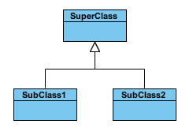
Generalization/Inheritance
A generalization is a taxonomic relationship between a more general class and a more specific class. Each instance of the specific classifier is also an indirect instance of the general class. Thus, the specific class inherits the features of the more general class.

Slide 70
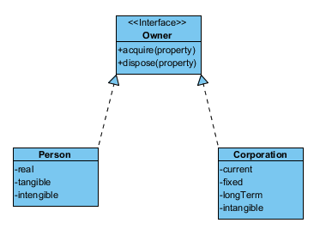
Realization
Realization is a relationship between the blueprint class and its derived class containing its respective implementation level details. This object is said to realize the blueprint class.

Slide 71

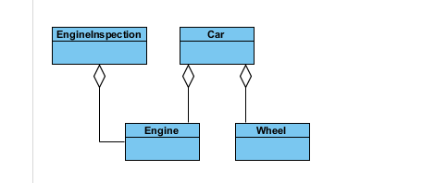
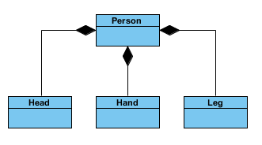


Comparision
Aggregation and Composition are specific cases of Association
In both aggregation and composition object of one class "owns" object of another class
Aggregation implies a relationship where the child can exist independently of the parent.
Example: Class (parent) and Student (child). Delete the Class and the Students still exist.
Composition implies a relationship where the child cannot exist independent of the parent.
Example: House (parent) and Room (child). Rooms don't exist separate to a House.

Slide 72
Design Patterns
Design patterns
Design patterns are template designs that can be used in a variety of systems. They are particularly appropriate in situations where classes are likely to be reused in a system that evolves over time.

Slide 73
Inheritance and Abstract Classes
Design patterns make extensive use of inheritance and realization
Inheritance (Generalization)
Classes can be defined in terms of other classes using inheritance. The generalization class is called the superclass and the specialization is called the subclass.
Realization
In realization, superclasses which contain abstract methods are defined such that concrete subclasses extend them by implementing the abstract methods (interface). Before a class derived from an abstract class can be instantiated it must implement concrete methods for all the abstract methods of its parent classes.

Slide 74
Adapter (Wrapper): Wrapping Around Legacy Code
Problem description:
Convert the interface of a legacy class into a different interface expected by the client, so that the client and the legacy class can work together without changes.
This problem often occurs during a transitional period, when the long term plan is to phase out the legacy system.
Example:
How do you use a web browser to access an information retrieval system that was designed for a different client?

Slide 75
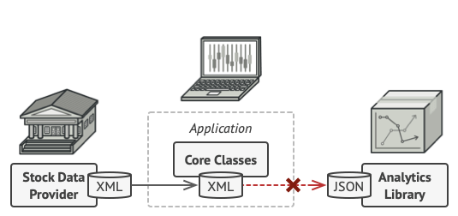
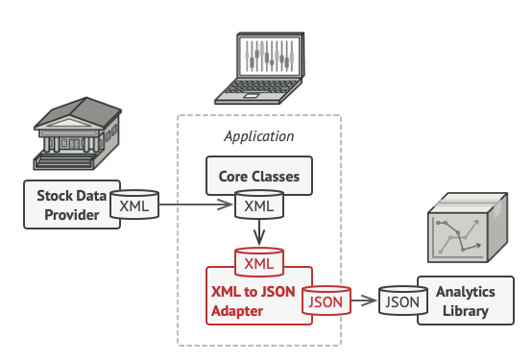
Adapter Design Pattern: The Problem

Slide 76
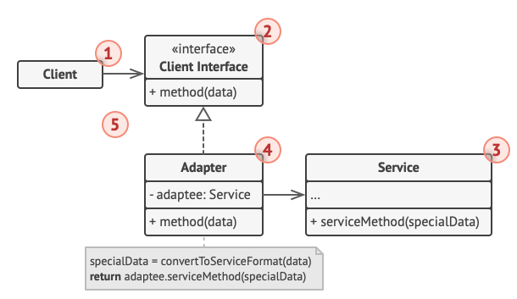
Adapter Design Pattern: Object Diagram
The Client is a class that contains the existing business logic of the program.
The Client Interface describes a protocol that other classes must follow to be able to collaborate with the client code.
The Service (Adaptee) is some useful class (usually 3rd-party or legacy). The client can’t use this class directly because it has an incompatible interface.
The Adapter is a class that’s able to work with both the client and the service.
Adaptee

Slide 77
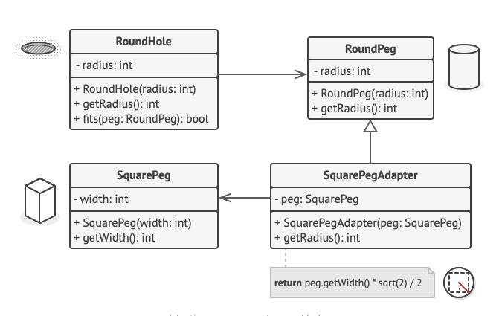
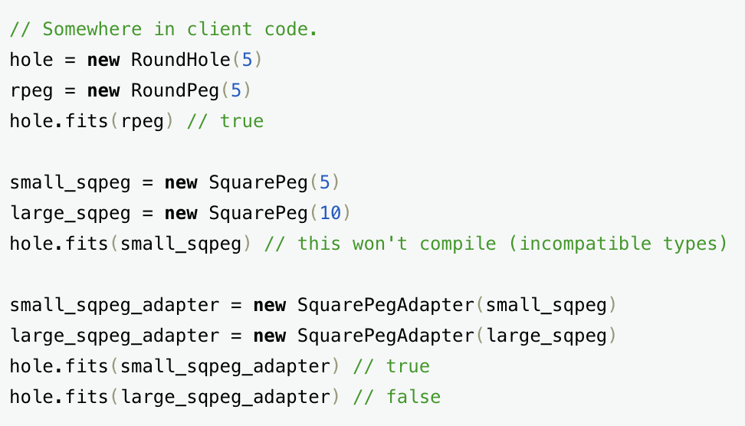

Slide 78
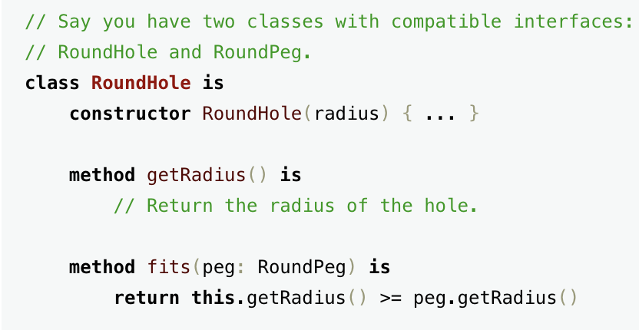
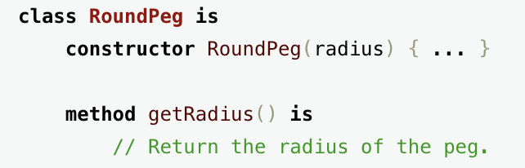

Slide 79
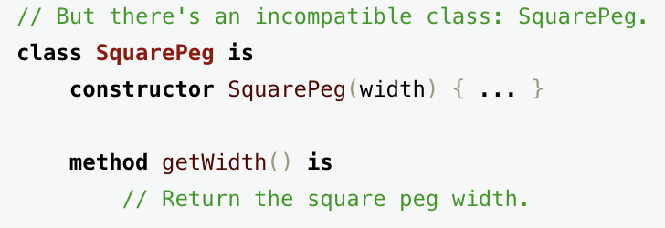
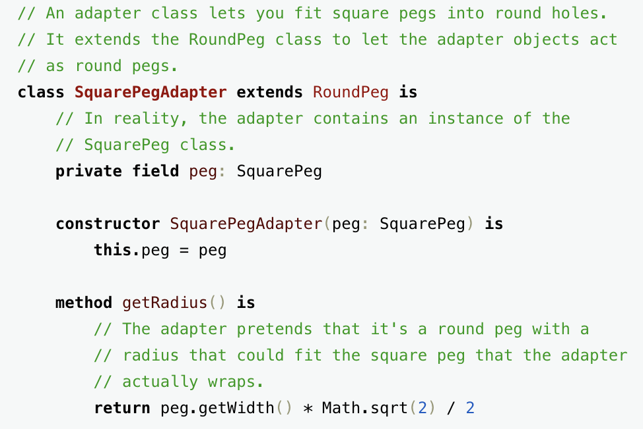

Slide 81
Adapter Design Pattern: Consequences
The following consequences apply whenever the Adapter design pattern is used.
Client and Adaptee work together without modification of either.
Adapter works with Adaptee and all of its subclasses.
A new Adapter needs to be written if Client is replaced by a subclass.

Slide 82
Bridge: Allowing for Alternate Implementations
Name: Bridge design pattern
Problem description:
Decouple an interface from an implementation so that a different implementation can be substituted, possibly at runtime (e.g., testing different implementations of the same interface).
Comparison of bridge and adapter design patterns
Bridge: defined interfaces that do not change
Adapter: legacy and new interfaces that have to work together

Slide 83
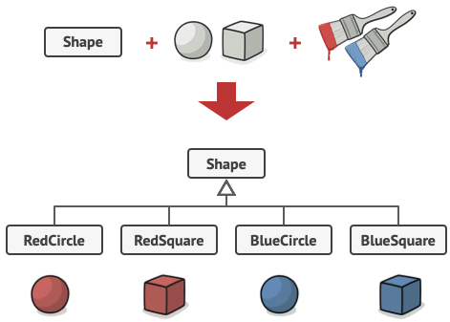
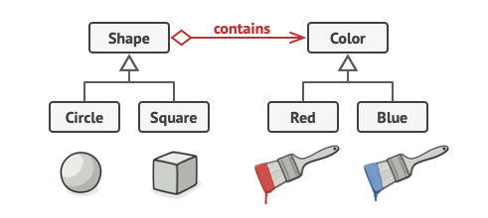
Bridge
Legacy
New

Slide 84
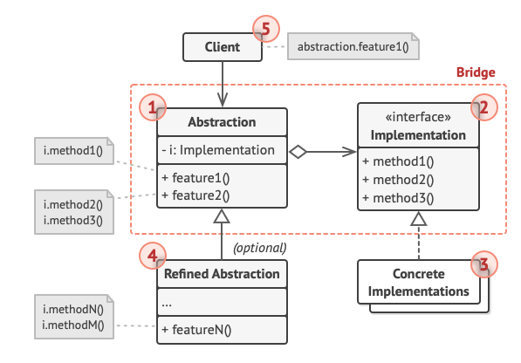
Bridge
The Abstraction provides high-level control logic. It relies on the implementation object to do the actual low-level work
The Implementation declares the interface that’s common for all concrete implementations. An abstraction can only communicate with an implementation object via methods that are declared here.
Concrete Implementations contain platform-specific code
Refined Abstractions provide variants of implementations via the general implementation interface.

Slide 85
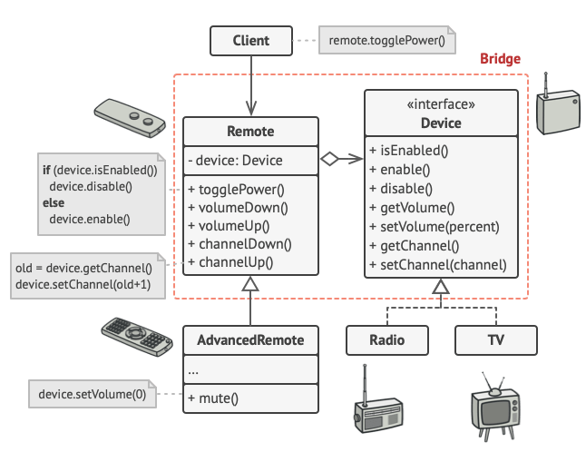
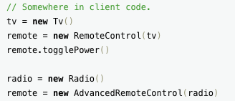

Slide 86
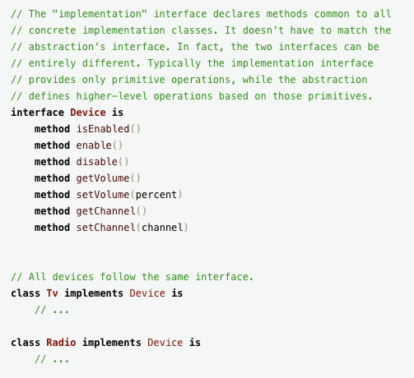
Bridge Example

Slide 87
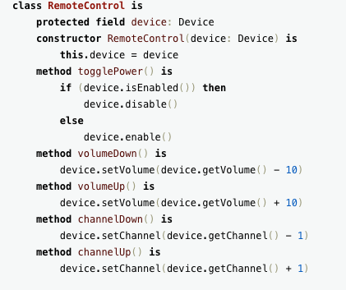
Bridge Example

Slide 88

Bridge Example

Slide 89

Bridge Example

Slide 90

Bridge Example

Slide 91
Bridge: Allowing for Alternate Implementations
Solution:
The Abstraction class defines the interface visible to the client.
Implementor is an abstract class that defines the lower-level methods available to Abstraction.
An Abstraction instance maintains a reference to its corresponding Implementor instance.
Abstraction and Implementor can be refined independently.

Slide 92
Bridge: Consequences
Consequences:
Client is shielded from abstract and concrete implementations
Interfaces and implementations can be tested separately

Slide 93
Strategy: Encapsulating Algorithms
Name: Strategy design pattern
Example:
In a calculator, you need to build various operations (add, multiply, substract, divide, etc).
Problem description:
Decouple a policy-deciding class from a set of mechanisms, so that different mechanisms can be changed transparently.

Slide 94

Strategy Example

Slide 95

Strategy Example

Slide 96

Design Pattern: Strategy

Slide 97

Design Pattern: Strategy

Slide 98

Design Pattern: Strategy

Slide 99

Design Pattern: Strategy

Slide 100
Strategy: Encapsulating Algorithms
Solution:
A Client accesses services provided by a Context.
The Context services are realized using one of several mechanisms
The abstract class Strategy describes the interface that is common to all mechanisms that Context can use.

Slide 101
Strategy: Consequences
Consequences:
ConcreteStrategies can be substituted transparently from Context.
Policy decides which Strategy is best, given the current circumstances.
New policy algorithms can be added without modifying Context or Client.

Slide 102
Bugs, Faults, and Failures
Bug (fault):
Programming or design error whereby the delivered system does not conform to specification (e.g., coding error, protocol error)
Failure:
Software does not deliver the service expected by the user (e.g., mistake in requirements, confusing user interface)

Slide 103
Building Reliable Software: Fault Tolerance
Aim:
A system that continues to operate when problems occur.
Examples:
Invalid input data (e.g., in a data processing application)
Overload (e.g., in a networked system)
Hardware failure (e.g., in a control system)
General Approach:
Failure detection
Damage assessment
Fault recovery
Fault repair

Slide 104
Static and Dynamic Verification
Static verification:
Techniques of verification that do not include execution of the software.
• May be manual or use computer tools.
Dynamic verification:
Testing the software with trial data.
Debugging to remove errors.

Slide 105
Dynamic Verification
Testing is most effective if divided into stages
User interface testing (carried out separately)
Unit testing
unit test
System testing
integration test
function test
performance test
installation test
Acceptance testing (carried out separately)

Slide 106

Terminologies
White/Glass/Open Box Testing
Involves testing the internal structure and workings of a software application.
Tester has access to the source code and uses this knowledge to design test cases
Task owner
Black/Box Testing
Tester is not concerned with the internal knowledge or implementation details of the software
Focuses on validating the functionality based on the provided specifications or requirements
Third party tester

Slide 107

Terminologies
Functional Testing
Test against the functional requirements and specifications
Unit Test/Integration Test/System Test/Smoke Test
Non-Functional Testing
Test against the non-functional requirements and specifications
Performance, Usability, Security, etc.

Slide 108


Terminologies
Unit Test
Testing individual units or components of a software application
Test data is usually chosen by developer(s) based on their understanding of specification and knowledge of the unit.
Created by the developer(s) of the unit or by special testers.
Integration Test
Testing units or components of a software application interact with each other
Incremental Test/Non-incremental Test (Big Bang Test)
System Test
Testing that evaluates the overall functionality and performance of a complete and fully integrated software solution

Slide 109
Test Cases
Test cases are specific tests that are chosen because they are likely to find specific problems.
Test cases are chosen to balance expense against chance of finding serious errors.
Cases chosen by the development team are effective in testing known vulnerable areas.
Cases chosen by experienced outsiders and clients will be effective in finding gaps left by the developers.
Cases chosen by inexperienced users will find other errors.
Test coverage are ways to measure "how much code" was tested
Statement (line) coverage
Branch coverage
Path coverage

Slide 110

System and Integration Test
Tests on components or complete system, combining units that have already been thoroughly tested.
Emphasis on integration and interfaces.
Trial data that is typical of the actual data, and/or stresses the boundaries of the system, e.g., failures, restart.
Carried out systematically, adding components until the entire system is assembled.
Can be black or white box: by development team or by special testers.
System testing is finished fastest if each component is completely debugged before assembling the next.

Slide 111



Terminologies
Bottom-up testing
Each unit is tested with its own test environment. Used for all systems.
Top-down testing
Large components are tested with dummy stubs. Particularly useful for:
user interfaces
work-flow
client and management demonstrations

Slide 112
Acceptance Testing
Acceptance testing
The complete system, including documentation, training materials, installation scripts, etc. is tested against the requirements by the client, assisted by the developers.
Each requirement is tested separately.
Scenarios are used to compare the expected outcomes with what the system does.
Emphasis is placed on how the system handles problems, errors, restarts, and other difficulties.
Is the system we have built, the system that you wanted? Does it meet your requirements?

Slide 113
Acceptance Testing with Agile Development
Incremental development
Acceptance testing is particularly important with agile development, since each sprint should end with completed code that is ready for release.
Each sprint should be a complete development process, ending with acceptance testing by the client and release.
If several sprints build on each other, each sprint may need to repeat the acceptance tests for earlier sprints to check that they are still met.

Slide 114
Resources for Acceptance Testing
Acceptance Testing is a important part of a software project.
It requires time on the schedule.
It may require substantial investment in test data, equipment, and test software.
Good testing requires good people.
Help systems and training materials are important parts of acceptance testing.

Slide 115
Acceptance Tests
Closed box by the client without knowledge of the internals.
The entire system is tested as a whole.
The emphasis is on whether the system meets the requirements.
The tests should use real data in realistic situations, with actual users, administrators, and operators.
The acceptance tests must be successfully completed before the new system can go live or replace a legacy system.
Completion of the acceptance tests may be a contractual requirement before the system is paid for.

Slide 116
Techniques for Release
The transition from the previous version of a production system to a new release is challenging.
Parallel Testing:
Clients operate the new system alongside the old production system with same data and compare results.
Alpha Testing:
Clients operate the system in a realistic but non-production environment
Beta Testing:
Clients operate the system in a carefully monitored production environment
A/B Testing:
Comparing two versions of a system against each other to determine which one performs better

Slide 117
Release: Parallel Testing
Parallel Testing
For data processing systems, such as financial systems, payroll, etc., the old and the new systems are run together for several productions cycles to check that the new system replicates the functionality of the old.
Requires two sets of everything (staff, equipment, etc.).
Requires software to control changeover (e.g., do not mail two sets of payments).
Requires automated scripts to compare results.
May take several months. Often, the new system will be brought into production in phases.

Slide 118
Release: Alpha and Beta Testing
Alpha testing can be done with software that lacks some functionality. Beta testing requires fully functional system.
Alpha and Beta testing must be managed.
If you simply make versions of the software available to clients:
Many clients will never use it.
Other clients will use a few features.
Only a few clients will test it systematically.
Only a few clients will report problems systematically.
What incentives can you give clients to test your software for you?
Financial (e.g., discounts on products)
Prestige (e.g., recognition, publicity)

Slide 119
Release: A/B Testing
In an A/B test, you take a webpage or app screen and modify it to create a second version of the same page.
Half of your traffic is shown the original version of the page (known as control or A) and half are shown the modified version of the page (the variation or B).
As visitors are served either the control or variation, their engagement with each experience is collected and analyzed through statistical analysis.
Developers can then determine whether changing the experience (variation or B) had a positive, negative or neutral effect against the baseline (control or A).

Slide 120
02
PART TWO
People

Slide 121
How to lead (Manage Down)
Clear and capable goals/roadmaps
Transparent
Learn to listen
No Micromanage
Be responsible, strongly motivated, flexible
Stimulate employees
Support employees’ decisions
Coach and develop employees’ skills
Aware of conflict and deal with its causes

Slide 122
Firmness
Managers must be firm when needed:
Assignment of tasks must be equitable and open; everybody will have to tackle some of the dreary tasks.
Carrots are better than sticks, but poor performance must be addressed.
Nobody is indispensable; nobody should be allowed to think that they are indispensable.

Slide 123
How to be productive
As a junior member of a team, what can you do to make it productive?
Follow the team's style of working
Understand the context of your work
Make practical suggestions
Ask for help if you need it
Accept less interesting tasks
Attend social events
Do good work

Slide 124
How to be led (Manage Up)
Be loyal and committed
Be proactive
See the big picture and understanding boss’s perspective
Providing solution, not problem
Exceed expectations
Go beyond your task
Keep you boss informed

Slide 125
Turning a Group Around
To turn a weak group into a strong one is the one of the greatest challenges of leadership.
The art of the possible
Promotion of the best over the old leaders
Using opportunities to reorganize
Resignations and terminations
Respect people who try, but refuse to accept problem areas
Persistent and firm is better than brutal and abrupt

Slide 126
Employment Law
As an employer:
If you employ people or supervise other people, you need to know the basics of employment law
N+1 for severance package
Many organizations run short courses for their supervisors or provide information about the key issues.
Be particularly careful about terminating people (firing).
If in doubt, consult a Human Relations (HR) expert.

Slide 127
Employment Law
When you start a job:
You will usually be asked to sign an employment contract.
Ask to read it before you accept the job.
If the contract contains unreasonable terms, do not sign.
Remember, you have bargaining power. Companies need people like you.
Internships:
Some companies exploit interns, but interns have legal rights.

Slide 128
Outsourcing
When might you contract with another organization to carry out some or all parts of the software development process?
The other organization might have expertise that your organization lacks.
Your organization might not have a large enough staff.
The other organization might have lower costs (e.g., it might operate in a country, such as India, where costs are lower).

Slide 129
Outsourcing
Risks
The other organization may not be as skilled as you expect.
Staff have their first loyalty to their own organization.
The other organization may have use different terminology or have a different culture (e.g., the organization may not report problems to the client).
Communication faces geographic and cultural differences.
Unless the task is well understood, it may be difficult to write a contract that manages costs and results (e.g., government contracts are notorious for cost over-runs).
If your organization contracts out all interesting work, your good staff will leave.

Slide 130
Outsourcing
Example
Company G was the world's leader in a specialized category of mathematical software. G had successfully implemented several packages for various manufacturers.
A computer company H contracted with G to develop a package for its new computer system.
The package for company H was late, performed badly and disliked by customers.
At the same time G was developing a package for company I. This package was very successful.
What went wrong? What can we learn?

Slide 131
Outsourcing
When work is out-sourced, the client must be vigilant.
The client must take responsibility for managing the relationships between the project and the client's organization.
The client must have a management and technical team that can track the work being done, monitor quality, review changes to scope, etc.
The contract should be explicit about expectations, deliverables, ownership of software, and mechanisms for payment.
The client must be closely involved with user testing and must control the acceptance testing.

Slide 132
Careers in Computer Science
What will you be doing one year from now? Ten years from now?
Careers outside computing
Careers in which you personally continue to do technical work
Careers in which you are responsible for the technical work of others
Entrepreneur – your own company

Slide 133
Careers outside Computer Science
A computing background can be valuable in any career: management, government, law, medicine, philanthropy, etc.
Education in computing is an asset:
Computing is a vital part of almost every organization
Education in logical thinking and tackling large tasks systematically
Education in computing is a potential weakness:
Not every problem can be solved by rational thinking alone
Importance of skills with people, judgment, etc.

Slide 134

The Connection to the Client: Typical Organization

Slide 135
Technical Careers
Super-technical positions
A very few senior positions which are almost entirely technical: e.g., industrial research, universities
Even these have substantial organizational aspects
Mid-level technical positions
Numerous mid-level professional positions
Can be state-of-the-art or dead-end
Computer professionals report satisfaction with their choice of careers.

Slide 136
Product Manager
The task of the Product Manager is to ensure that the right product is built and that the right trade-offs are made between timeliness, functionality, and costs.
This requires an understanding of:
Marketing and business considerations
Technical options and design criteria
Communication among groups with different expertise and priorities
A good Product Manager has strong technical and management skills (e.g., a computer scientist with an MBA).

Slide 137
Careers that take Responsibility for the Technical Work of Others
A common career progression is from being a technical expert to leading others who do technical work
Senior personnel must be familiar with both the strategic organizational aspects and the computing aspects of the work, e.g.,
Entrepreneur
Chief Information Officer
Senior consultant
Requires good technical insight, not detailed technical expertise
Requires organizational, marketing, personnel, financial expertise
Product management is a good background for such positions

Slide 138
Chief Information Officer
The senior person in an organization responsible for technology.
Usually a vice president.
Other job titles include Chief Technology Officer.
Background is probably a combination of technology and management.
May have worked as a consultant (possibly internal consultant).
Requires strategical technical expertise.

Slide 139
Entrepreneur
Computer specialist have founded many of the world’s great companies
It is easier for a computer specialist to obtain management expertise than for a management generalist to become a technical expert.
It is easier to start young before you have mortgages, children, etc.
Do not be afraid of failure. It is quite usual to fail at the first attempt, but succeed later.

Slide 140
Career Flexibility
Nobody knows the future of computer science, but …
If you do not learn continuously, you are going out of date fast
Go to seminars, conferences, training courses
Be inquisitive – discover things for yourself
Technical expertise is most valuable when combined with other skills
Understand the organization that you are part of, e.g., budgets, marketing
Develop organizational skills, e.g., presentations, writing, leadership

Slide 141
Changing Organizations
If you change organizations, behave in a professional manner:
Show respect for the organization that you leave
Respect trade secrets (public information is not confidential)
Take nothing with you except personal items
Do not poach customers and staff
Show enthusiasm for your new organization
Embrace their culture
Do not criticize relative to old organization

Slide 142
Thanks for your listening!
Instructor: Liu, Guangchi Ph.D.

